Slide 1


Introduction to React Native Core Components
Welcome to our guide on React Native's essential building blocks. This presentation will help you understand the core components needed to build cross-platform mobile apps.
You'll learn how to leverage JavaScript and React to create native applications that run seamlessly on both iOS and Android.

Slide 2
The Power of Cross-Platform Development
One Codebase
Native Performance
JavaScript Powered
Write once, run everywhere. React Native lets you maintain a single codebase for multiple platforms.
Apps built with React Native deliver the smooth, responsive experience users expect.
Leverage your existing JavaScript and React skills to build mobile apps.

Slide 3
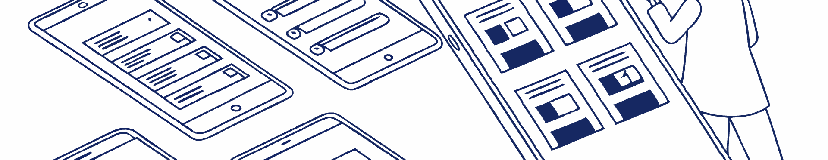




Core Components Overview
View
Text
The fundamental building block container for layout.
Displays and styles textual content in your app.
Image
Text Input, Button, ScrollView, FlatList
Renders local and remote images with customizable styles.
Additional components for interactivity and data display.

Slide 4
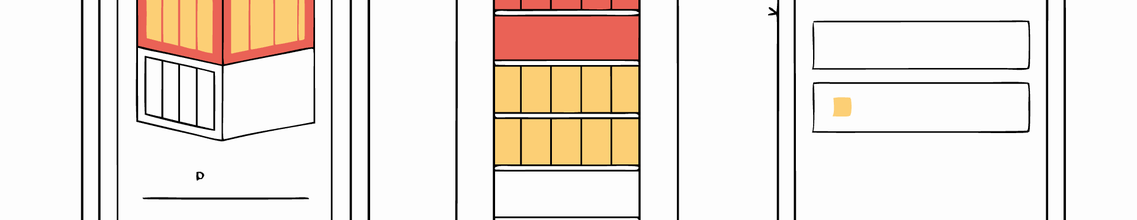
The View Component
Purpose
Features
Syntax
Acts as a container for other components. The most fundamental building block in React Native.
Flexbox layout capabilities
Use opening and closing tags. Apply styles through the style prop that references a style object.
Styling options
Touch handling
Accessibility support

Slide 5
View Syntax
import React from 'react';
import { View, Text, StyleSheet } from 'react-native';
const MyComponent = () => {
return (
<View style={styles.container}>
<Text>Hello, World!</Text>
</View>
);
};
const styles = StyleSheet.create({
container: {
flex: 1,
justifyContent: 'center',
alignItems: 'center',
},
});
export default MyComponent;

Slide 6








The Text Component
Display Text
Style Text
Renders strings and text content visibly on the screen.
Apply fonts, colors, alignment, and other typographic styles.
Handle Touch
Nest Text
Respond to press events directly on text elements.
Place Text components inside one another for mixed styling.

Slide 7
Text syntax
import React from 'react'; import { Text, View } from 'react-native'; const MyTextComponent = () => { return ( <View> <Text style={{ fontSize: 20 }}>Hello, React Native!</Text> <Text style={{ color: 'blue' }}>This is a basic text component.</Text> </View> ); }; export default MyTextComponent;

Slide 8
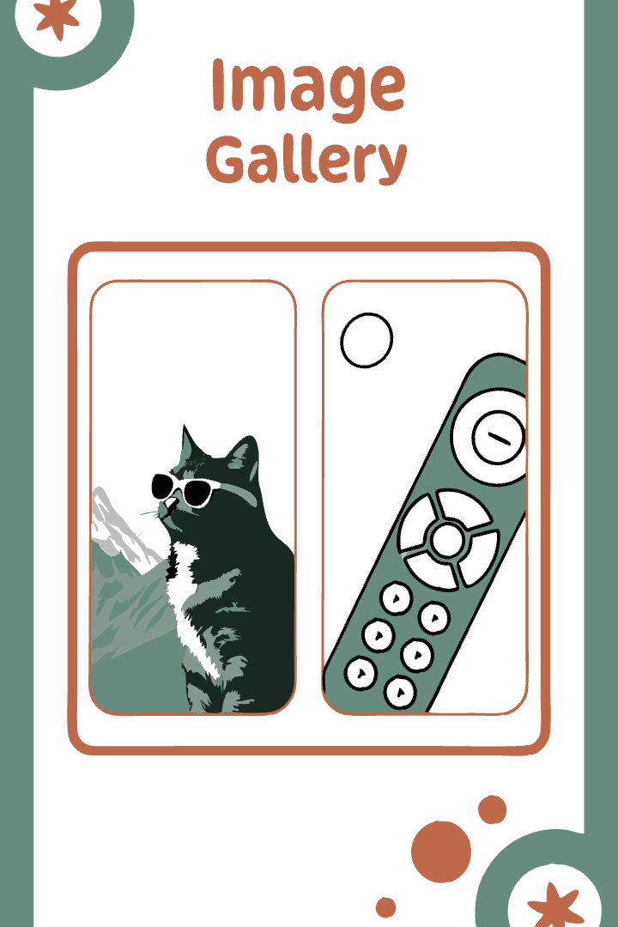
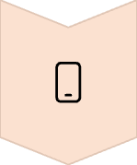


The Image Component
Local Images
Import and display images bundled with your app.
Remote Images
Load images from URLs and external sources.
Style & Resize
Control dimensions, borders, and other visual aspects.

Slide 9
Image syntax
import React from 'react'; import { Image, View } from 'react-native'; const MyImageComponent = () => { return ( <View> <Image source={require('./localImage.png')} style={{ width: 200, height: 200 }} /> <Image source={{ uri: 'https://example.com/remoteImage.png' }} style={{ borderRadius: 10 }} /> </View> ); }; export default MyImageComponent;

Slide 10






Interactive Components
User Interaction
Create responsive, interactive experiences.
Button Component
Simple clickable elements with onPress handlers.
TextInput Component
Capture user input with customizable fields.

Slide 11
Button syntax
import React from 'react';
import { Button, View } from 'react-native';
const MyButtonComponent = () => {
return (
<View style={{ margin: 20 }}>
<Button
title="Press Me"
onPress={() => alert('Button Pressed!')}
/>
</View>
);
};
export default MyButtonComponent;

Slide 12
TextInput syntax
import React, { useState } from 'react';
import { TextInput, View, StyleSheet, Text } from 'react-native';
const MyTextInputComponent = () => {
const [text, setText] = useState('');
return (
<View style={styles.container}>
<TextInput style={styles.input} placeholder="Enter some text" onChangeText={setText} value={text} />
<Text>You typed: {text}</Text>
</View>
);
};
const styles = StyleSheet.create({
container: {
padding: 20,
},
input: {
height: 40,
borderColor: 'gray',
borderWidth: 1,
marginBottom: 12,
padding: 10,
},
});
export default MyTextInputComponent;

Slide 13
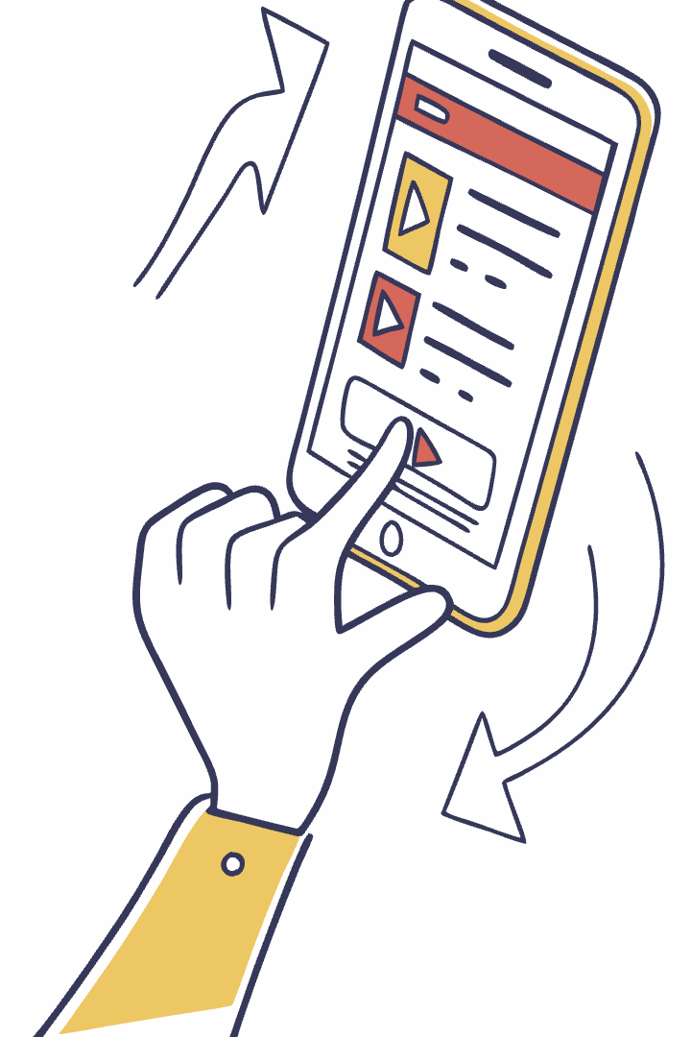
ScrollView Component
Purpose
Contains components larger than the viewport, enabling users to scroll through content.
Implementation
Wrap content in ScrollView tags and apply styling as needed.
Best Practices
Use for limited content. For long lists, consider FlatList for better performance.

Slide 14
ScrollView syntax
import React from 'react';
import { ScrollView, Text, StyleSheet } from 'react-native';
const MyScrollViewComponent = () => {
return (
<ScrollView style={styles.scrollView}>
<Text style={styles.text}>Item 1</Text>
<Text style={styles.text}>Item 2</Text>
<Text style={styles.text}>Item 3</Text>
<Text style={styles.text}>Item 4</Text>
{/* More items can be added here */}
</ScrollView>
);
};
const styles = StyleSheet.create({
scrollView: {
marginHorizontal: 20,
},
text: {
fontSize: 20,
marginVertical: 10,
},
});
export default MyScrollViewComponent;

Slide 15



FlatList Component
Performance Optimized
Renders only visible items for efficiency.
Data Driven
Accepts an array of data to display.
Customizable Rendering
Define how each item appears with renderItem.

Slide 16
FlatList syntax
import React from 'react'; import { FlatList, Text, View, StyleSheet } from 'react-native'; const MyFlatListComponent = () => { const data = [ { key: 'Item 1' }, { key: 'Item 2' }, { key: 'Item 3' }, { key: 'Item 4' }, ]; return ( <FlatList data={data} renderItem={({ item }) => <Text style={styles.item}>{item.key}</Text>} /> ); }; const styles = StyleSheet.create({ item: { padding: 10, fontSize: 18, height: 44, }, }); export default MyFlatListComponent;

Slide 17

Putting It All Together
7
2
Core Components
Platforms
Essential building blocks for React Native apps.
iOS and Android from one codebase.
1
Framework
Unified approach to mobile development.

